Slide 1
The Project and Framework
What is embedding equality and diversity in the curriculum?
What is the framework for embedding equality and diversity in the curriculum?
How can we use it?

Slide 2
Embedding Equality and Diversity in the Curriculum (EEDC)
The Embedding Equality and Diversity in the Curriculum (EEDC) project is funded by the Scottish Funding Council to offer support to Scottish HEIs in the context of the increasing diversity of the student body and strengthening of legislative duties to proactively promote equality, eliminate discrimination and foster good relations; all of which call for a re-examination of the management, design and delivery of learning, teaching and assessment so as to incorporate (rather than add on) equality and diversity.

Slide 3
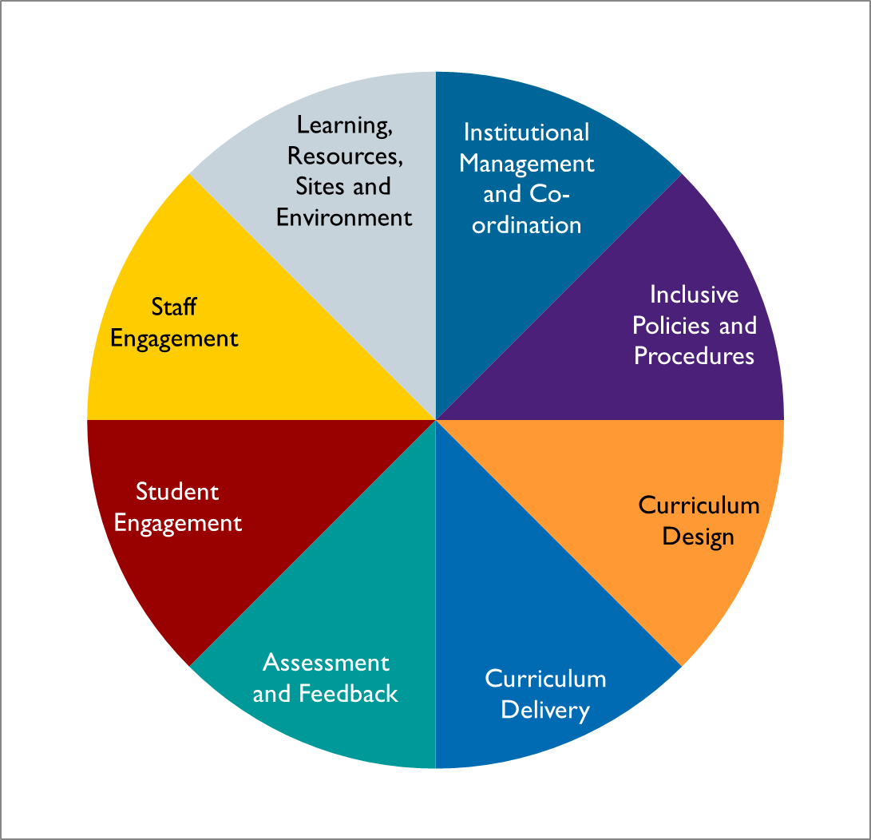
The HEA EEDC Framework

Slide 4
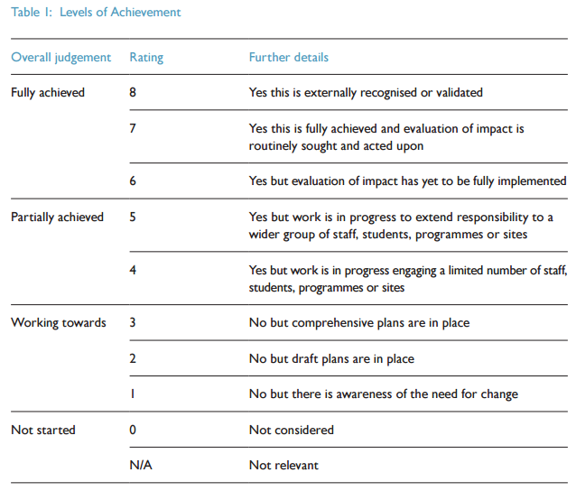
The HEA EEDC Framework Ratings

Slide 5
Action Research
What is the theory behind EEDC;
What are the strategies behind a. inclusivity and b. diversity inclusivity;
What activities that can be utilised in achieving a. inclusivity and b. diversity inclusivity.

Slide 6
Embedding Equality and Diversity in the Curriculum: The Theory
Inclusivity
Diversity Competence
Diversity Inclusivity
Belonging
Engagement
Potential
Self Reflection
Understanding
Exposure
Interaction

Slide 7
Belonging and Engagement
Facilitating potential
Creating Inclusivity: creating learning experiences which provide all students, regardless of their background, with the opportunity to fulfill their own learning potential and support other students who may wish to learn from them.

Slide 8
Inclusivity
Curriculum content:
What is taught? Consider syllabus material (e.g. texts, theories, laboratory experiments).
Curriculum delivery
How is it taught? Consider mode of teaching (lecture, seminar, group-work, peer-learning), minutiae of teaching (what images are used to accompany teaching? What language is used?)
Assessment and feedback
What is the content of the assessment? What type of assessment is it? How far is choice built in? How far is co-creation built in? What type of feedback is given? In what way (e.g. is it oral, written, group?)

Slide 9
Activity: Inclusivity
In your groups:
Thinking only about inclusivity (belonging and engagement and facilitating potential), think of concrete examples for how inclusivity could be created.
Come up with at least two examples per category of curriculum content, curriculum delivery and assessment and feedback.
Write your examples on a post-it note with a statement as to your role in its implementation.
Example:
Assessment and feedback in Classics:
Idea: create an alternative to the dissertation (e.g. group production of play)
Role: work with lecturers and programme leaders on creating guidelines and support for creating the alternative method of assessment.

Slide 10
Embedding Diversity Inclusivity: creating learning experiences which include considerations of cultural diversity through curriculum content, assessment design and pedagogical practices.
Understanding and Exposure
Interaction
Self reflection

Slide 11
Diversity Inclusivity
Curriculum content:
What is taught? Consider syllabus material (e.g. texts, theories, laboratory experiments).
Curriculum delivery
How is it taught? Consider mode of teaching (lecture, seminar, group-work, peer-learning), minutiae of teaching (what images are used to accompany teaching? What language is used?)
Assessment and feedback
What is the content of the assessment? What type of assessment is it? How far is choice built in? How far is co-creation built in? What type of feedback is given? In what way (e.g. is it oral, written, group?)

Slide 12
Activity: Diversity Inclusivity
In your groups:
Thinking only about diversity inclusivity (interactivity, exposure and understanding, and self-reflection), think of concrete examples for how diversity inclusivity could be created.
Come up with at least two examples per category of curriculum content, curriculum delivery and assessment and feedback.
Write your examples on a post-it note with a statement as to your role in its implementation.
Example:
Curriculum content in Art and Design:
Idea: in a class on understanding current exhibitions, artwork and plays and their place in culture, students should decide on which exhibitions etc. they want to explore.
Role: work with lecturers and programme leaders on creating guidelines and agree that each student should prepare one case study per course for analysis.

Slide 13
What Next?
Today: Action Planning
And beyond: EEDC Strategic Enhancement Programme

Slide 14
Contact Details
Dr Pauline Hanesworth
Academic Development Officer (Equality and Diversity), Scotland
The Higher Education Academy Scotland
Holyrood Park House
106 Holyrood Road
Edinburgh
EH8 8AS
Email pauline.hanesworth@heacademy.ac.uk
Check out the web page: https://www.heacademy.ac.uk/node/11014
Keep in touch through EEDC bulletin: https://my.heacademy.ac.uk/
Follow us on Twitter! - @HEA_EDScotland

